Slide 1
Discrete Mathematics BCSC 0010
Module 2 Normal Forms

Slide 2
Normal forms
If the number of variables , involved in a given statement are more, then the construction of truth tables may not be practical, therefore, we consider other method known as reduction to normal form.
In this method, we use the word
“product” in place of “conjunction”
“sum” in place of “disjunction”

Slide 3
Some Basic terms Related to Normal Form
Elementary Product: A product of the variables and their negations is called an elementary product.
Eg: Let p and q be any two variables, then p, q, pΛq, ~ p Λ ~ q, p Λ ~q, ~p Λ q….. etc. are elementary products.
Elementary Sum: A Sum of the variables and their negations is called an elementary sum.
Eg: p, q, pVq, pV ~ q, ~ p V ~ q, ~pVq….. etc. are elementary sums.

Slide 4
Types of Normal Form
Disjunctive Normal Form(DNF)
Conjunctive Normal Form(CNF)

Slide 5
Disjunctive Normal Form(DNF)
A statement which consists of a sum of elementary products of propositional variables and is equivalent to the given compound statement, is called a disjunctive normal form of the given statement.
This form is not unique for the given statement.

Slide 6
Method to obtain disjunctive normal form
Step1. replace → and ↔ by Λ, V, and ~ in the statement.
Step 2. Manipulate to get an equivalent form which is the sum of elementary product terms.

Slide 7
Example
Obtain DNF of (p→q)^~q
Solution:
(p→q)^~q
(~pvq)^~q By logical equivalence
(~p^~q)v(q^~q) By Distributive law
This is the required DNF

Slide 8
Conjunctive Normal Form(CNF)
A statement which consists of a product of elementary sums of propositional variables and is equivalent to the given compound statement, is called a Conjunctive normal form of the given statement.
This form is not unique for the given statement.

Slide 9
Method to obtain conjunctive normal form
Step1. replace → and ↔ by Λ, V, and ~ in the statement.
Step 2. Manipulate to get an equivalent form which is the product of elementary sum terms.

Slide 10
Example
Obtain CNF of (p→q)^~q
Solution:
(p→q)^~q
(~pvq)^~q By logical equivalence
This is the required CNF

Slide 11
Example
Obtain DNF of pv(~p→(qv(q→~r)))
pv(~p→(qv(q→~r)))
pv(~p→(qv(~q v ~r))) By logical equivalence
pv (~p→(qv~q)v~r))) Rearranged
p v p v q v ~q v ~r By logical equivalence
This is the required DNF

Slide 12
Minterms
Let p and q be two propositional variables.
All possible formulas which consist of product of p or its negation and product of q or its negation, but should not contain both the variable and its negation in any one of the formula are called minterms of p and q.
Eg: For two variables p and q, there are 2² = 4 minterms, namely,
pΛq, pΛ~q, ~pΛq, ~pΛ~q
If there are n variables then number of minterms = 2^{n}

Slide 13
Maxterms
Let p and q be two propositional variables.
All possible formulas which consist of sum of p or its negation and sum of q or its negation, but should not contain both the variable and its negation in any one of the formula are called maxterm of p and q.
Eg: For two variables p and q, there are 2² = 4 maxterms, namely,
pVq, pV~q, ~pVq, ~pV~q.
If there are n variables then number of maxterms = 2^{n}

Slide 14
Principal disjunctive normal form(PDNF)
For a given formula, an equivalent formula consisting of disjunction of minterms only is known as its Principal disjunctive normal form (PDNF) or Sum of products canonical form.
Each minterm has truth value T for exactly one combination of truth values
A formula which is tautology will have all minterms
A formula which is contradiction will have no minterms

Slide 15
Method to find PDNF
1. Construct truth table for the given formula.
2. Identify the rows in which the formula has true – as truth value.
3. Construct minterms from each such rows by taking
(i) the variable with true – as variable itself and
(ii) the variable with false – as negated variable.
4. Sum of these minterms will be the required PDNF.

Slide 16
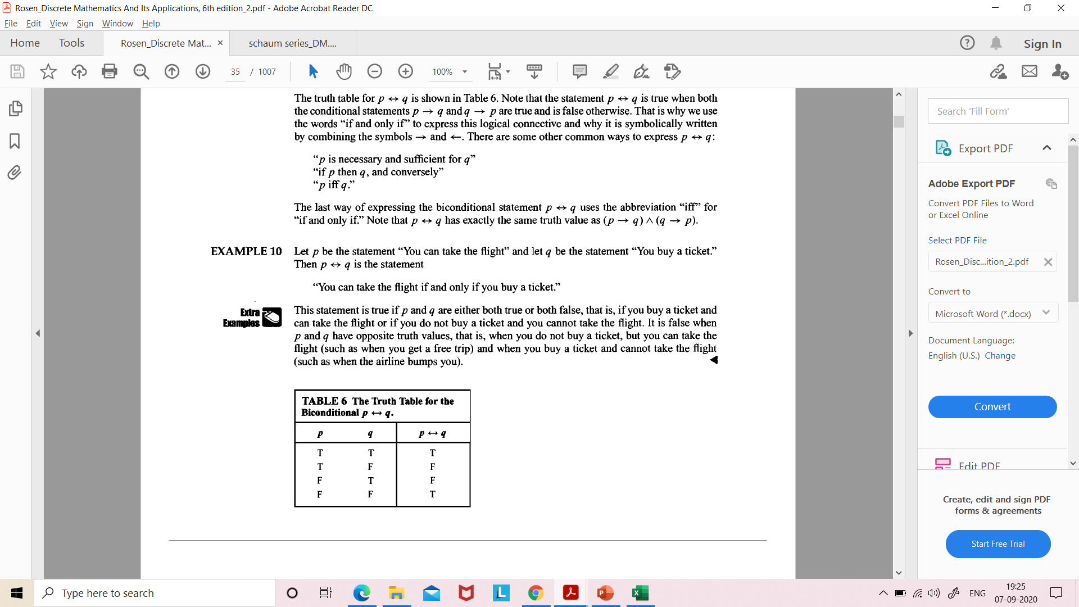
Example
PDNF for p→q will be (p^q)v(~p^q)v(~p^~q)
PDNF for p ↔q will be (p^q)v(~p^~q)

Slide 17
Obtain PDNF of (p^q)v(~p^r)v(q^r)
p | q | r | ~p | p^q | ~p^r | q^r | (p^q)v(~p^r) | (p^q)v(~p^r)v(q^r)
T | T | T | F | T | F | T | T | T
T | T | F | F | T | F | F | T | T
T | F | T | F | F | F | F | F | F
T | F | F | F | F | F | F | F | F
F | T | T | T | F | T | T | T | T
F | T | F | T | F | F | F | F | F
F | F | T | T | F | T | F | T | T
F | F | F | T | F | F | F | F | F
PDNF: (p ^q^r)v(p^q^~r)v(~p^q^r)v(~p^~q^r)

Slide 18
Principal conjunctive normal form(PCNF)
For a given formula, an equivalent formula consisting of conjunction of maxterms only is known as its Principal disjunctive normal form(PCNF) or product of sums canonical form.
Each maxterm has truth value F for exactly one combination of truth values
A formula which is tautology will have no maxterms
A formula which is contradiction will have all maxterms

Slide 19
Method to find PCNF
1. Construct truth table for the given formula.
2. Identify the rows in which the formula has false – as truth value.
3. Construct maxterm from each such row by taking
(i) the variable with true -as negated variable and
(ii) the variable with false- as the variable itself.
4. Product of these maxterms will be the required PCNF.

Slide 20
Example
PCNF for p→q will be (~pvq)
PCNF for p ↔q will be (~p vq)^(p v ~q)

Slide 21
Obtain PCNF of (p^q)v(~p^r)v(q^r)
p | q | r | ~p | p^q | ~p^r | q^r | (p^q)v(~p^r) | (p^q)v(~p^r)v(q^r)
T | T | T | F | T | F | T | T | T
T | T | F | F | T | F | F | T | T
T | F | T | F | F | F | F | F | F
T | F | F | F | F | F | F | F | F
F | T | T | T | F | T | T | T | T
F | T | F | T | F | F | F | F | F
F | F | T | T | F | T | F | T | T
F | F | F | T | F | F | F | F | F
PCNF: (~pvqv~r)^(~pvqvr)^(pv~qvr)^(pvqvr)

Slide 22
Example
Obtain PCNF of (pvq)^~p→~q
Obtain CNF of ~(pvq) ↔ (p∧q)
Obtain DNF of ~(pvq) ↔ (p∧q)

Slide 23
Next Topic
Predicate and Quantifiers

